Slide 1
Samantha Baker
Natural Resource Specialist II
Broward County Environmental Planning & Community Resilience Division

Slide 2
Goals & Objectives
Achieve and sustain a minimum 10% County-wide per capita reduction in water use
30 MGD in water savings over 20 years
Encourage a stronger water conservation ethic among water users through increased public education and outreach
Provide incentives and resources to residents for significant water savings through plumbing retrofits
High Efficiency Toilets
Water Saving devices

Slide 3
Program Accomplishments
Over $573,000 in rebates issued
Over 6,000 toilets replaced
3,013 bathroom aerators
2,912 kitchen aerators
4,536 showerheads and other water saving devices distributed
Over 206 mil. gallons of water saved
SFWMD /Water Saving Incentives Program $50,000/yr. for 4 years

Slide 4
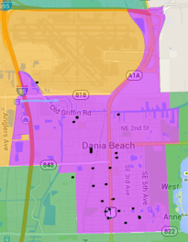
Dania Beach is a Great Partner!
Provided over 100 rebates
One of our most active partners promoting indoor water conservation
Successfully awarded nearly $10,000 in rebates and devices to residents
Has been awarded nearly $2300 in state funding

Slide 5
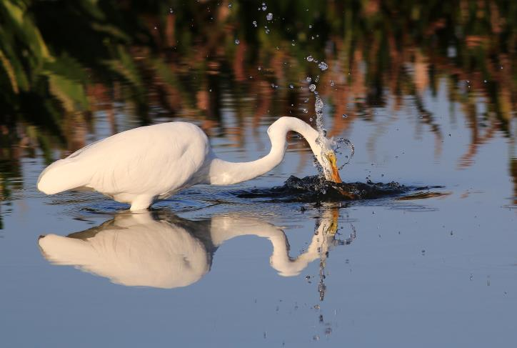
We’re making a SPLASH!
Water conserving appliances and fixtures save money!
The investment is recouped in a short time
Conservation is a triple bottom line: You save water, you save money and you are helping protect our S. Florida lifestyle!
We’re having some fun!

Slide 6
Our 2015 Campaign
EXCITING, Different
Engaging, SOCIAL
Content Creating
Earned Media Producing
BWP Program!
Coming March 1- 31, 2015

Slide 7
It’s called…

Slide 8
Our Goals:
The BWP is SOCIAL!
Raise Awareness
Gain Participation
Increase Conservation (and conversation!)

Slide 9
The Grand Prize
One lucky winner will be selected to win:
WaterOptimizer® irrigation system
New Energy and Water Saving Fridge, Washer/Dryer, Dishwasher
Fixtures for kitchen and bath
WaterSense® Toilets

Slide 10
Here’s How:
Partner communities will have up to 3 drop off locations
Applicants can submit online
No purchase necessary, but they have to be creative!

Slide 11
There’s Some Thinking to Do!
Applicants Must:
Reside in a partner community & be a water customer
Completely fill out an application
Provide creative supporting material that promotes & reinforces the water conservation theme. Examples include:
Build a website
Write a poem
Perform a song
Prepare an essay or poster
Prepare social media campaign to get likes/followers
Anything that can be evaluated!
The winner agrees to allow monitoring of water savings for 1 year.

Slide 12
How People Will Find Out
Advertising (Radio, TV, Newspaper, Billboards, Social Media)
We’ve been talking to PIO’s and partner reps.
Facebook Contests
Twitter Contests
YouTube Contests
Promotions through partner communities-
Utility Bills
Facebook
Twitter
Website Links and Cross Promotions
Emails to Residents
Newsletters from elected officials
Posters
Flyers
Webpages
And more!

Slide 13
Public/Private Partnerships

Slide 14
We’re Going to Earn Some Media Too
Humor
Going Viral
Results
Content
Music
Sub-promotions using social media
Inspiration
Partners

Slide 15
How Can the City of Dania Beach Celebrate a Winner?
Newsletters
Website Messaging
Press Releases
Social Media
Presentations

Slide 16
bwpSwitcheroo.com
Coming March 1-31, 2015

Slide 17
Questions?
Samantha Baker
Broward Water Partnership
Program Manager
stbaker@broward.org
954-519-1222

